Slide 1

Robot Algorithm
Module
Rohit Kumar

Slide 2
Contents
Title | Page
Edge Avoiding Robot
Obstacle Avoiding Robot

Slide 3
Edge Avoiding Robot
The purpose of this robot is to keep moving on a platform without falling from it. For this it detects the edge of the platform and avoid edge by turning to opposite side for example if it detects an edge to its right, it turns to left and vice versa.

Slide 4
Hardware requirements
Arduino Uno
IR Sensors
DC Motor Driver L293D
DC Motor
Power Supply

Slide 5
Description
The sensors are mounted at front end of the robot at both left and right side. The sensors are designed to detect the light reflecting from the platform on which it is moving and at the edge, sensors don’t get this light. The robot starts moving on platform and until it is on the platform it is receiving the reflected light and robot keeps moving. As soon as it reaches the edge (say left edge), the left sensor doesn’t receives the light and the comparator sends logic 0 to the microcontroller for the left sensor. On getting this condition the microcontroller make the robot to turn right by turning only the left motor ON and making the right side motor OFF. Reverse will happen if the right sensor detects the edge.
In this way the robot keeps moving on the platform and doesn’t fall by avoiding the edges.

Slide 6
Edge Avoider
LEFT SENSOR | RIGHT SENSOR | MOVEMENT
ON | ON | FORWARD
OFF | ON | DELAY; RIGHT TURN; DELAY;
ON | OFF | DELAY; LEFT TURN; DELAY;
OFF | OFF | DELAY; RIGHT TURN; DELAY;

Slide 7
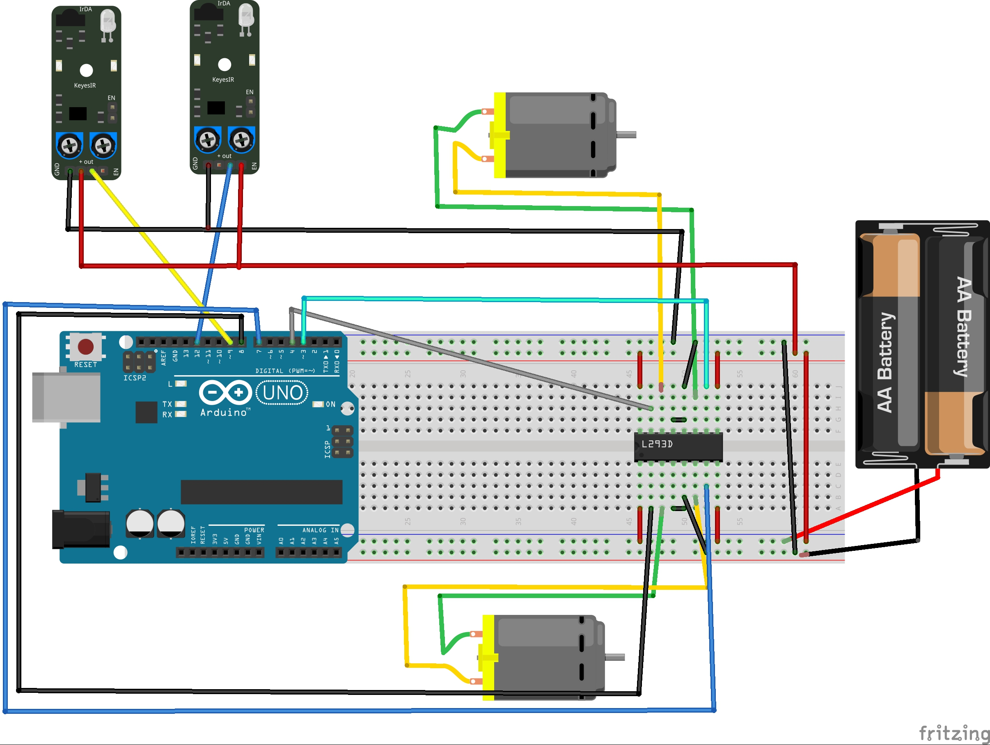
Schematic

Slide 8
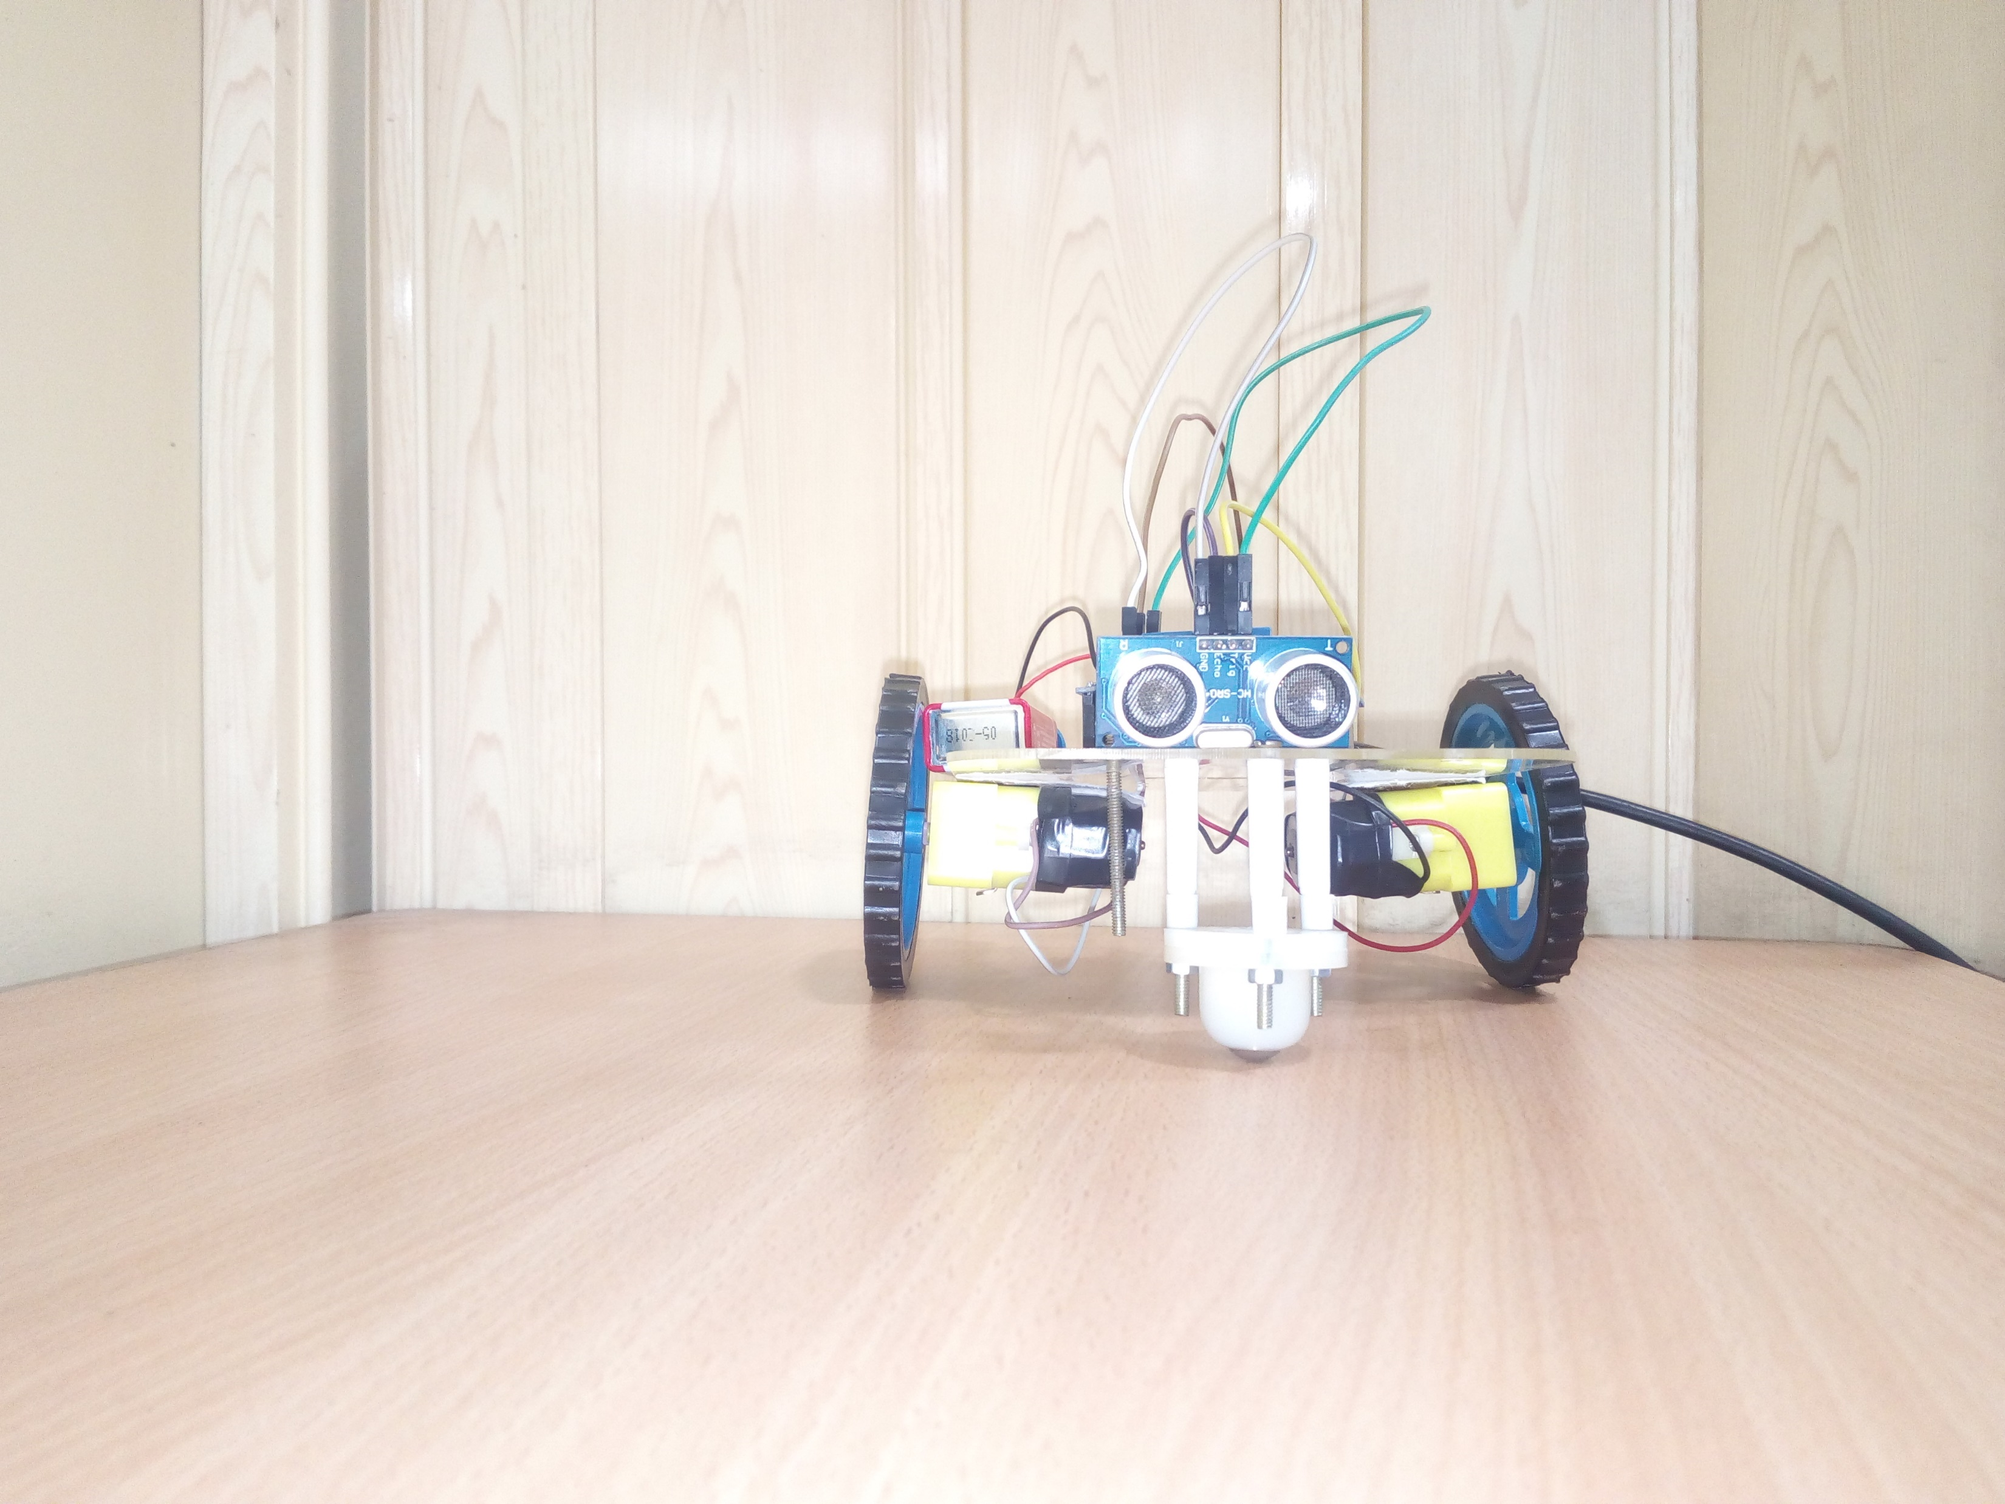
Obstacle Avoiding Robot
The obstacle avoiding robot is used for detecting obstacles and avoiding the collision.

Slide 9
Hardware requirements
Arduino Uno
Ultrasonic sensor (HC SR04)
DC Motor Driver L293D
DC Motor
Power Supply

Slide 10
Block Diagram

Slide 11
Description
Here we are going to implement a robot which is going to detect obstacle and according to that, it going to change its direction.
Now first we are going to connect ultrasonic sensor with our Arduino board. Then according to program our ultrasonic sensor going generate a trigger signal which is going receive by our echo pin of Ultrasonic sensor.
Then we are going to run an algorithm according which we are going to manipulate our desire distance for obstacle detection then we are going to control our motor rotation direction for movement of our robot.

Slide 12
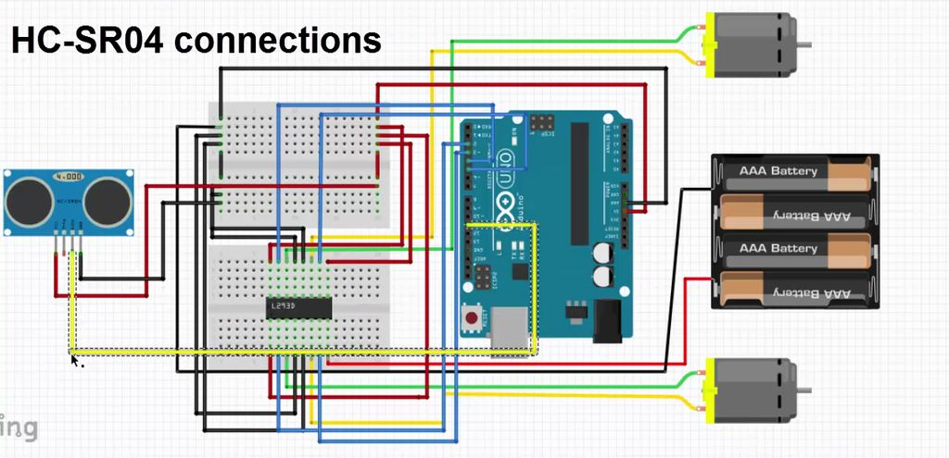
Schematic

Slide 13
Thank You !
Contact US
Nitin Sinha
nitin.sinha@goSigmaWay.com
+1 727-394-4375
+91 7838188809
Debjani Mitra
debjani.mitra@goSigmaWay.com
+1 952-583-3449
+91 9339555636
Rohit Kumar
rohit.kumar@sigmaway.us
+91 7982577830
+91 7838021754

